Slide 1
Selenium
Session 8
Page Object Model

Slide 2
What is POM
It is an object/element design pattern to create object repositories for web elements (ex. Links, button, edit box etc..)
Create separate Object Repository to store object locators
For each web page there should be a separate page class
The page class will have all object locators and preferably action methods for the corresponding page
STEPS
Step 1 : Create a class for each web page
Step 2 : Add object locators
Step 3 : Create class for test
Step 4 : Refer objects from page classes
Step 5 : Run and validate

Slide 3
Benefits of POM
Test Objects and Functions are separated for easy maintenance and keeping the code clean
Objects are kept separated from test scripts and can be used multiple times in multiple tests
Every unique object locator is created only once
Easy Maintenance and Less Rework

Slide 4
A] Create Page Class
package pageObjectModel;
import org.openqa.selenium.By;
import org.openqa.selenium.WebDriver;
public class LoginPage {
WebDriver driver;
//Create element using element locator
By Username=By.xpath("//input[@name='username']");
By Password=By.xpath("//input[@name='password']");
By LoginButton=By.xpath("//span[@class='ui-button-text']");
//Create constructor - A constructor in Java is a block of code similar to a method
//That is called an instance of object is created
//this keyword is used to invoke or instantiate current class constructor
public LoginPage(WebDriver driver) {
this.driver=driver;
}

Slide 5
//Create user actions
public void typeUsername(String uname) {
driver.findElement(Username).sendKeys(uname);
}
public void captureUsername() {
driver.findElement(Username).getAttribute("value");
}
public void clearUsername() {
driver.findElement(Username).clear();
}
public void typePassword(String PWD) {
driver.findElement(Password).sendKeys(PWD);
}
public void clickLoginButton() {
driver.findElement(LoginButton).click();
}
}

Slide 6
B] Create Test Case in new class to login to Admin portal
package pageObjectModel;
import org.openqa.selenium.WebDriver;
import org.openqa.selenium.chrome.ChromeDriver;
public class LoginTestCase {
public static void main(String[] args) {
//Instantiate browser driver
System.setProperty("webdriver.chromedriver", "c:/chromedriver.exe");
WebDriver driver = new ChromeDriver();
//Create object of page class
LoginPage loginObj=new LoginPage(driver);
//Create Admin Login Test Case
driver.get("http://www.gcrit.com/build3/admin/");
loginObj.typeUsername("admin");
loginObj.typePassword("admin@123");
loginObj.clickLoginButton();

Slide 7
String url=driver.getCurrentUrl();
if (url.contains("http://www.gcrit.com/build3/admin/index.php")) {
System.out.println("Admin login successful - PASS");
}
else {
System.out.println("Admin login unsuccessful - FAIL");
}
driver.close();
}
}

Slide 8
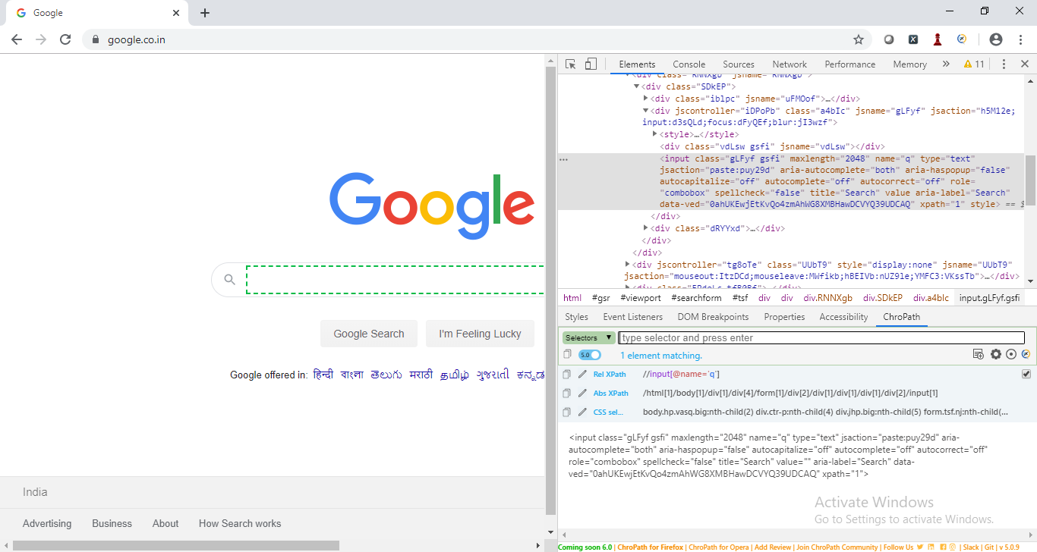
Tool to find xpath
Download ChroPath

